Slide 1
Welcome to eDrafter.in Corporate Presentation

Slide 2
Problem
You all must have made some sort of Legal Document in your life like an Affidavit, Rental Agreement or any other sort of document on stamp paper and you must be aware of the pain.
The Legal Documentation market size is about 100 billion dollars in India and all of it is operated offline in an unorganized way.
The Major Issues in attaining the documents:
Physical Visits to Court
Waiting in Long Queues
Paying Uncertain Amount to Agent
Wasting a lot
of time

Slide 3
IDea

Slide 4
Our Products
E-Stamp Paper of 20+ states
100+ Affidavits and Agreements
Print on e-Stamp Paper

Slide 5
Process at edrafter.in

Slide 6
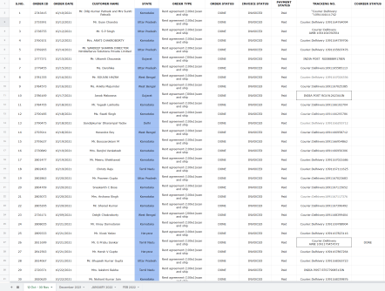
B2b Process (1 -Manual)

Slide 7
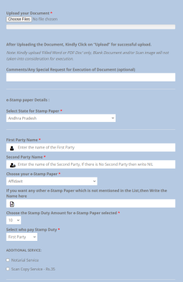
B2b Process (2-Throughportal)

Slide 8
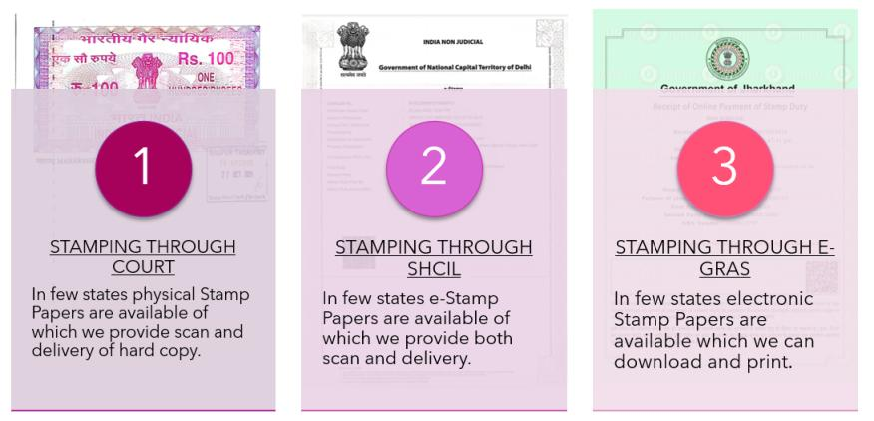
Types of Stamping process in india

Slide 9
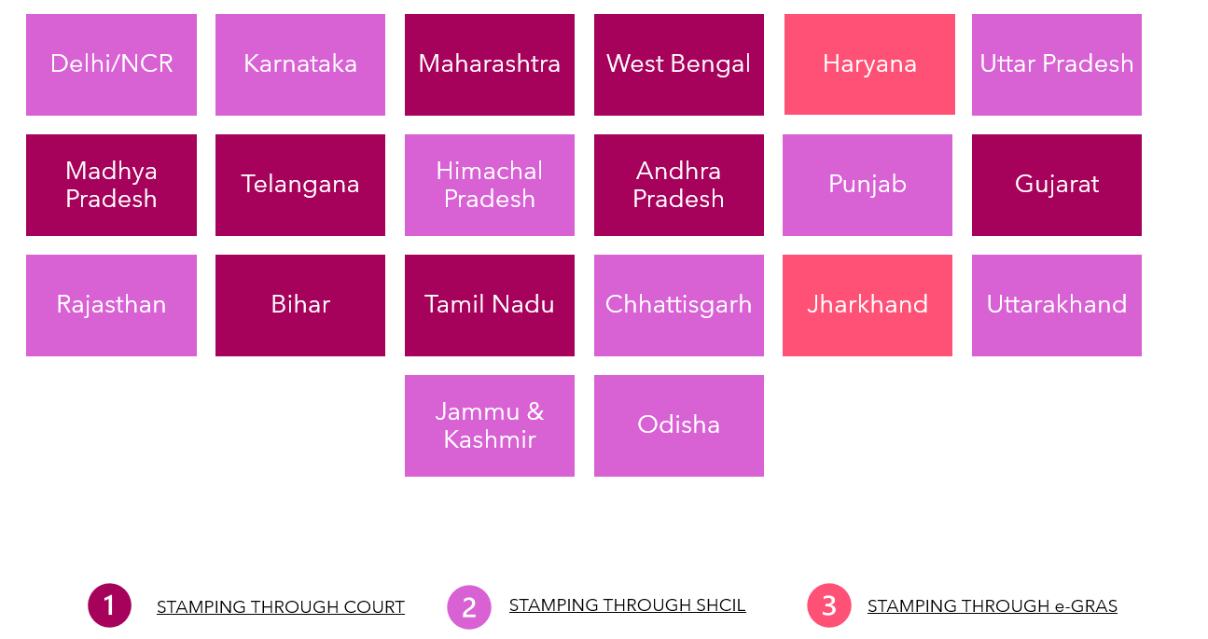
Our reach

Slide 10
Strengths
Saves a lot of Time and Money
Educated and onboarded
a lot of Stamp Vendors Online.
Spreading awareness and giving literacy about the legal documents.
Facilitated services in more than 20+ States of India
Helping Indian Citizens Globally for Legal Documentation Needs

Slide 11
Clientelle

Slide 12
Awards & Recognition
Ratings

Slide 13
THANK YOU

